Slide 1
Software Quality Management

Slide 2
Software Quality Management
Concerned with ensuring the required level of quality is achieved in a software product
Involves the definition of appropriate quality standards and the definition of procedures to ensure that these standards are followed
Works best when a ‘quality culture’ is created where quality if seen as everyone’s responsibility

Slide 3
Quality Definition
Quality means that a product satisfies the demands of its specifications
It also means achieving a high level of customer satisfaction with the product
In software systems this is difficult
  customer quality requirements (e.g. efficiency or reliability) often conflict with developer quality requirements (e.g. maintainability or reusability)
  software specifications are often incomplete, inconsistent, or ambiguous

Slide 4
Quality Management Activities
Quality assurance
  establishing organizational quality standards and procedures
Quality planning
  selecting and modifying applicable quality standards and procedures for a particular project
Quality control
  ensuring quality standards and procedures are followed by development team
Note: Quality management should be separated from project management to ensure independence.

Slide 5
ISO 9000
International set of standards for quality management
Quality standards and procedures must be documented in an organizational quality manual
An external body is often used to certify that the quality manual conforms to ISO 9000 standards
Many customers are demanding that suppliers are ISO 9000 certified

Slide 6
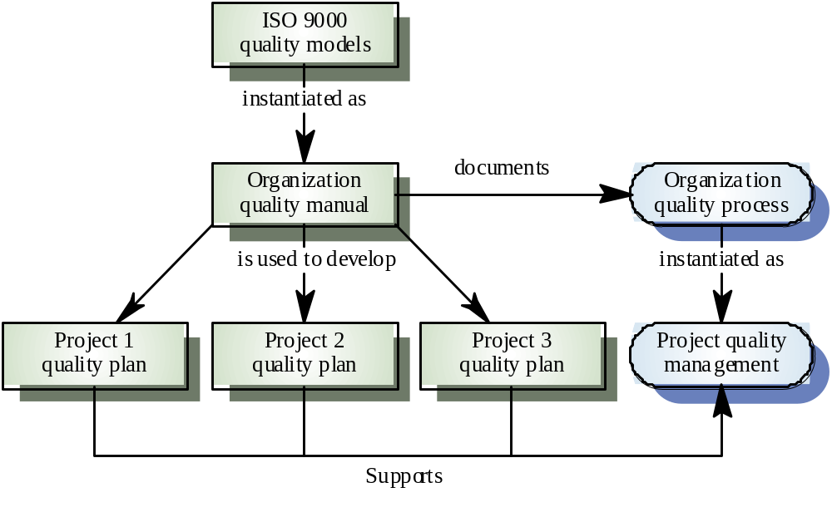
ISO 9000 and quality management

Slide 7
Quality Standards
Key to effective quality management
Product standards define the characteristics exhibited by all components (e.g. programming style issues)
Process standards describe how a software process is to be implemented
Should encapsulate best practices - this helps avoid repeating past mistakes
Provide continuity by giving new team members a means to understand the organizational priorities

Slide 8
Process and Product Standards
Product Standards
  Design review form
  Document naming standards
  Function prototype format
  Programming style standards
  Project plan format
  Change request form
Process Standards
  Design review guidelines
  Document submission procedures
  Version release process
  Project plan approval procedure
  Change control process
  Test data recording procedures

Slide 9
Problems with Standards
Sometimes viewed by software engineers as neither up-to-date or relevant to the current project
Can involve lots of bureaucratic form completion and submission
Often not supported directly by software tools and this can mean lots of manual work to maintain standards

Slide 10
Quality Standards Development
Should involve practitioners in their development
Engineers must understand the rationale behind each standard
Standards must be reviewed and revised regularly to avoid obsolescence and credibility problems with practitioners
Detailed standards need tool support to eliminate the “too much clerical work” excuse for not following the standards

Slide 11
Documentation Standards
Documentation process standards
  describe how documents are to be developed, validated, and maintained
Document standards
  concerned with document content, structure, and appearance
Document interchange standards
  specify how documents are to be stored and shared between different documentation systems

Slide 12
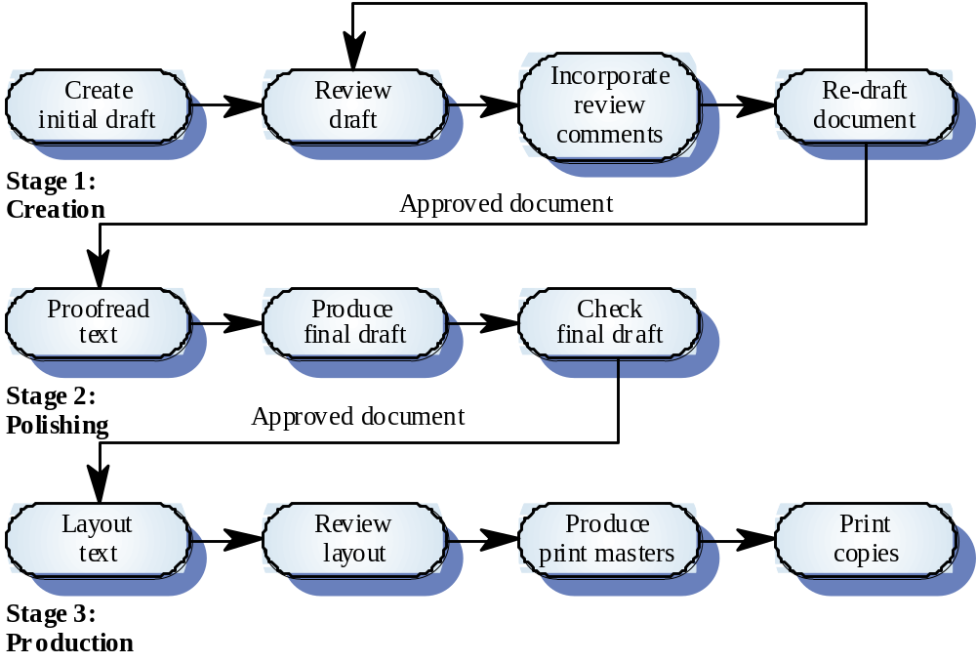
Documentation process

Slide 13
Document Standards
Document identification standards
  how documents are labeled
Document structure standards
  organization of project documents
Document presentation standards
  fonts, styles, logos, etc.
Document update standards
  change control and version definition

Slide 14
Document Interchange Standards
Allow documents produced on different computers, using different tools to be exchanged among team members
The lifetime of many word processing systems is often less than the lifetime of the software being documented, document archival can be tricky
Document interchange standards like XML are beginning to emerge as partial solutions to these problems

Slide 15
Process-Based Quality
Product quality is influenced by the quality of its production process
This relationship is easy the see in the manufacture of goods, it is more complex for software production because
  the application of individual skills and experience is particularly important in software development
  external factors (e.g. application novelty or need to accelerate schedule) are more likely to impair quality

Slide 16
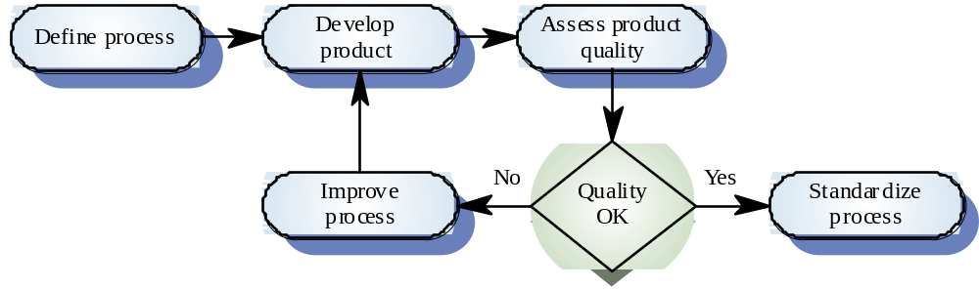
Process-Based Quality Activities

Slide 17
Process Quality Overview
Determine the process standards to be used (e.g. review procedures, configuration management, etc.)
Monitor the development process to ensure standards are being followed
Report process findings to project manger and customerProcess-based quality

Slide 18
Quality Plan
Identifies the most significant quality attributes appropriate for the product
Defines the assessment process in detail for each quality attribute
Indicates which organization standards should be applied and defines new standards as necessary

Slide 19
Quality Plan Components
Product introduction
Product plans
Process descriptions
Quality goals
Risks and risk management

Slide 20
Software Quality Attributes
Safety
Security
Reliability
Resilience
Robustness
Understandability
Testability
Adaptability
Modularity
Complexity
Portability
Usability
Accessibility
Reusability
Efficiency
Learnability

Slide 21
Quality Control
Examines the software development process to ensure that all relevant procedures and standards are being followed
Two basic approaches
  quality reviews
  software measurement and assessment

Slide 22
Reviews
Reviews are the principle means of validating both process and product quality
Basic procedure is to have a group of people examine a process artifact to find potential problems
Common software review types include
  defect inspection and removal (product)
  progress reviews (product and process)
  quality reviews (product and standards)

Slide 23
Quality Reviews
Group of knowledgeable people examines a software component and its documentation
Code, design models, specifications, test plans, standards, etc. can be subjected to review
Once an artifact has been reviewed and ‘signed off’ by the reviewers, management has given its approval to proceed to the next stage of development

Slide 24
Quality Review Process
Select a review team
Arrange a time and place for the review
Distribute documents to review
Conduct the review
Complete the review forms
Decide whether to approve artifacts or have them reworked and review them again

Slide 25
Review Purposes
Quality function
  part of the general quality management process
Project management function
  provide information to project managers
Training and communication function
  product knowledge is shared among development team members

Slide 26
Quality Review Results
Purpose is the discovery of system defects and inconsistencies
Review comments need to be classified as
  no action (no changes to artifact are required)
  refer for repair (author needs to correct faults)
  reconsider overall design (problem identified impacts other design components)
Requirement and specification problems may require involvement of client to resolve

Slide 27
Software Measurement and Metrics
Software measurement is concerned with deriving a numeric value for an attribute of a software product or process
This allows for object comparisons bewteen techniques or processes
The systematic use of measurement is essential to process improvement programs

Slide 28
Software Metric
Any type of measurement that relates to a software system, process, or document
  LOC, person-months, function points
Metrics allow for the quantification of the software or a software process
May be used to predict product attributes or to control the software process

Slide 29
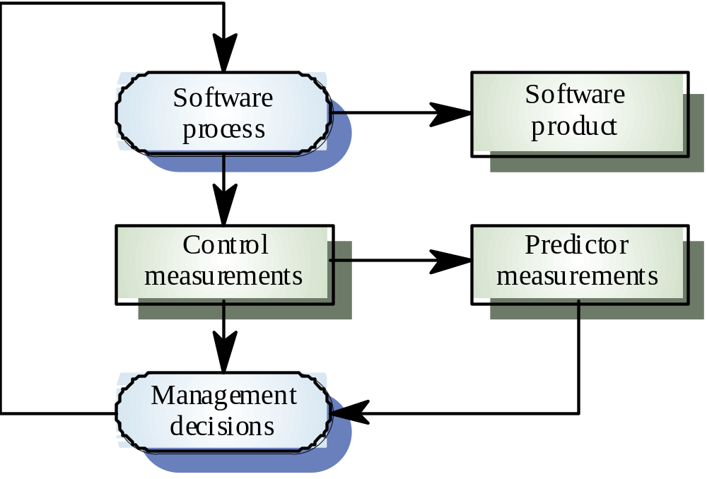
Predictor and Control Metrics

Slide 30
Metrics Assumptions
The software property of interest can be measured
There is a known relationship between what we want to measure and what we want to know
The relationship has been formalized and validated
It may be difficult to relate what can be measured to desirable quality attributes

Slide 31
Measurement Process
The software measurement process may be part of a quality control process
Data collected during the measurement process should be maintained as an organizational strategic resource
Establishing a measurement database allows comparisons between and across projects

Slide 32
Product Measurement Process
Choose measurement to be made
Select components to be assessed
Measure component characteristics
Identify anomalous measurements
Analyze anomalous components

Slide 33
Data Collection
A good metrics program is based on a set of identifiable product and process data
Data should be collected immediately (not retrospectively)
Use automatic data collection if possible
  static product analysis
  dynamic product analysis
  process data collection

Slide 34
Automated Data Collection
Instrumented software system
  monitors added to software to record necessary data unobtrusively
Usage data
  capture user inputs and transactions
Fault data
  make use of electronic media to record faults as they are uncovered

Slide 35
Data Accuracy
Don’t collect unnecessary data
  decide the questions to be answered in advance and only collect relevant data
Tell people why data is being collected
  make sure people understand that the product and process are being evaluated (not the employees)
Don’t rely on people’s memory
  collect data as it is being generated, not after a project is completed

Slide 36
Product Metric Classes
Dynamic metrics
  measurements made on executing program
  help assess things like efficiency and reliability
Static metrics
  measurements made of some system representation
  help assess things like complexity, understandability, and maintainability

Slide 37
Dynamic and Static Metrics
Dynamic metrics
  closely related to software quality attributes
  it is fairly easy to measure response time (performance) or number of failures (reliability)
Static metrics
  are indirectly related to quality attributes
  you may need to use statistics to derive relationships between static metrics and attributes like complexity or maintainability

Slide 38
Static Metrics
Fan-in
  number of functions that call a particular function
Fan-out
  number of functions called by a particular function
Length of code
  size of program (LOC or KLOC)
Cyclomatic complexity
  measures control complexity inside program
Fog index
  average word and sentence lengths in documents

Slide 39
Object-Oriented Static Metrics
Depth of inheritance tree
  distance between root class and instances
Method fan-in/fan-out
  wise to distinguish between method calls within a class and between classes
Weighted class methods per class
  number of methods in a class weighted by complexity of each method
Number of overriding operations
  superclass operations redefined in subclass

Slide 40
Customer Satisfaction
PVM (valid problems per user month)
How do you improve PVM?
  Reduce product defect injection rates during development
  Improve support, usability, documentation, communication, or training
  Increase sales of installed licenses (spreads same number of problems over more user months)

Slide 41
Maintenance Metrics
Defect arrivals by time interval
Customer problem calls
Backlog management index (BMI)
  100% * (# problems fixed this month)/(# arriving this month)
Percent of delinquent fixes
  100% * (# fixes by that exceed fix time standards)/(total # fixes)

Slide 42
Measurement Analysis
It is not always obvious what the data means
Data analysis is difficult
Consult professional statisticians when necessary
Data analyses should take local circumstances into account

Slide 43
Measurement Surprise
Reducing the number of faults in a program may lead to an increased number of help desk class
Program is now perceived as more reliable and may have a wider market (a lower percentage of calls may net a larger number of calls)
People are less willing to work around faults in a system that has a reputation for reliability and this may lead to more calls for help

